Slide 1
User Analytics in the Telecommunication Industry - Overview
A Comprehensive Analysis of Opportunities in the Telecommunication Sector
NAME: MINAL DEVIKAR
INSTITUTION: DIGICHROME ACADEMY

Slide 2

1
Defining the Challenge
Understanding the Need
Investors seek undervalued assets and require detailed data analysis to understand business fundamentals. Identifying profit trends is crucial. This approach has proven successful in identifying profitable routes, as seen in previous analyses that boosted company profits significantly. Understanding customer demographics and behavior is vital for projecting profitability in any industry, including telecommunications. The focus is now on analyzing TellCo to determine its potential for growth and profitability in the competitive market.
Photo by Pexels

Slide 3

2
Understanding TellCo
Market Position
TellCo is an established mobile service provider in the Republic of Pefkakia with untapped potential in its data. Current ownership has not utilized data analytics, representing an opportunity for a fresh analytical approach to drive improvements. Evaluating their existing customer data will highlight behavior patterns crucial for predicting future sales and growth. Success will hinge on understanding and addressing the unique needs of TellCo's diverse customer base.
Photo by Pexels

Slide 4
3
Introduction
Objective
The primary goal of this analysis is to evaluate Telco's growth potential in the telecommunications market. By examining user behavior and interaction with the network, we aim to provide insights into whether investing in Telco is a sound decision.
This assessment is based on a detailed analysis of user data, focusing on their engagement levels, experience, and overall satisfaction with Telco's services.
The analysis will help identify potential opportunities for improvement and growth, which are critical in making informed business decisions.

Slide 5
4
Scope
This analysis is divided into four key areas, each providing a different perspective on TellCo's user base and performance:
User Overview: A summary of user activities such as data consumption (upload and download), session durations, and the total number of sessions. This section gives insight into general usage trends and user behavior on the network, highlighting the most and least active users.
User Engagement: Analysis of how users interact with TellCo's services. This includes the number of sessions, session durations, and data usage across different applications (e.g., social media, streaming). By clustering users into groups based on their engagement, we can identify highly engaged users and potential churners.
User Experience: This section evaluates the quality of service users receive, focusing on technical metrics like TCP retransmission, round trip time (RTT), and throughput. By analyzing these factors, we can understand how network performance affects user experience and determine areas where TellCo's service quality might be impacting user satisfaction.
User Satisfaction: Using a combination of engagement and experience scores, we assess how satisfied TellCo's customers are. Satisfaction is a key indicator of loyalty and long-term customer retention. We use clustering and predictive models to identify satisfaction patterns and forecast future trends in customer satisfaction.

Slide 6
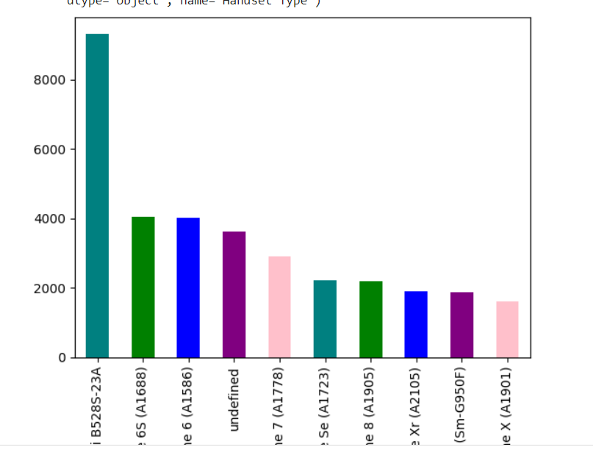
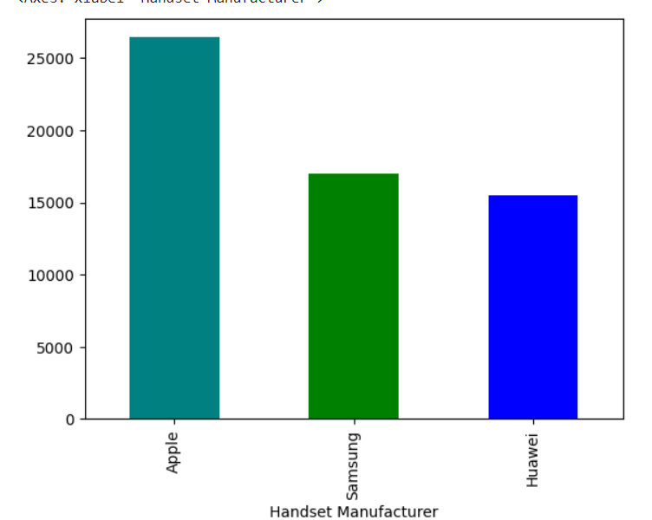
5
Interpretation:
Most Popular Phones: Huawei B528S-23A leads, followed by popular iPhones and the Samsung Galaxy S8. Many devices are listed as 'undefined.'
Top Manufacturers: Apple dominates with 27,529 users, followed by Samsung and Huawei with strong but smaller user bases.
Recommendation:
Focus on Popular Models: Prioritize Huawei B528S-23A and Apple iPhones with special offers.
Fix Data Issues: Address 'undefined' devices for better clarity. Promote services for the Samsung Galaxy S8.
Targeted Strategies: Tailor marketing and product efforts to Apple, Samsung, and Huawei users while tracking trends.
Task 1 - User Overview Analysis
Top 10 handsets used by the customers
Top 3 handset manufacturers

Slide 7
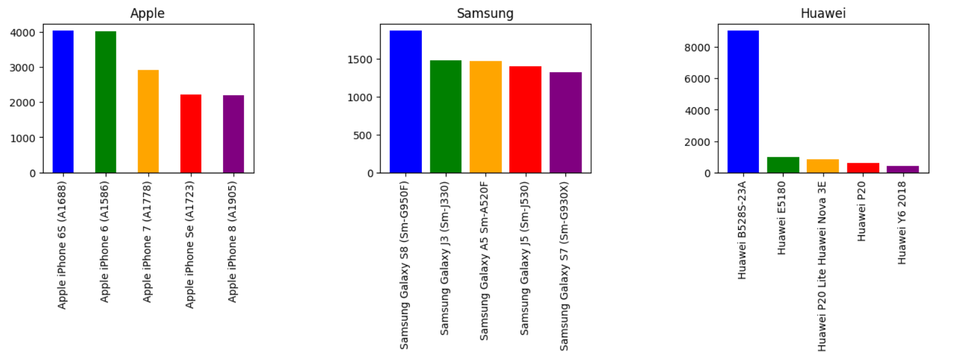
6
Interpretation:
Apple has a high preference for its older iPhone models.
Samsung users have a diverse preference but favor the Galaxy S8.
Huawei users predominantly choose the B528S-23A, with a few other models also popular.
Recommendation:
Apple: Focus on accessories and services for older iPhone models.
Samsung: Tailor marketing strategies for the Galaxy S8 while offering support for other popular models.
Huawei: Prioritize products and services for the B528S-23A, and consider promoting other popular Huawei models
Top 5 handsets per top 3 manufacturers

Slide 8
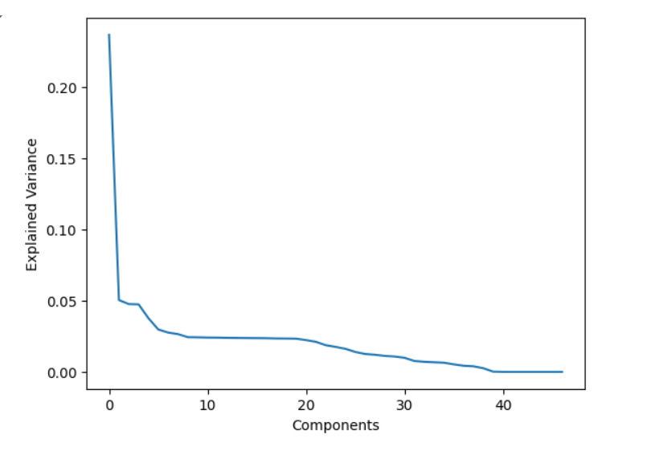
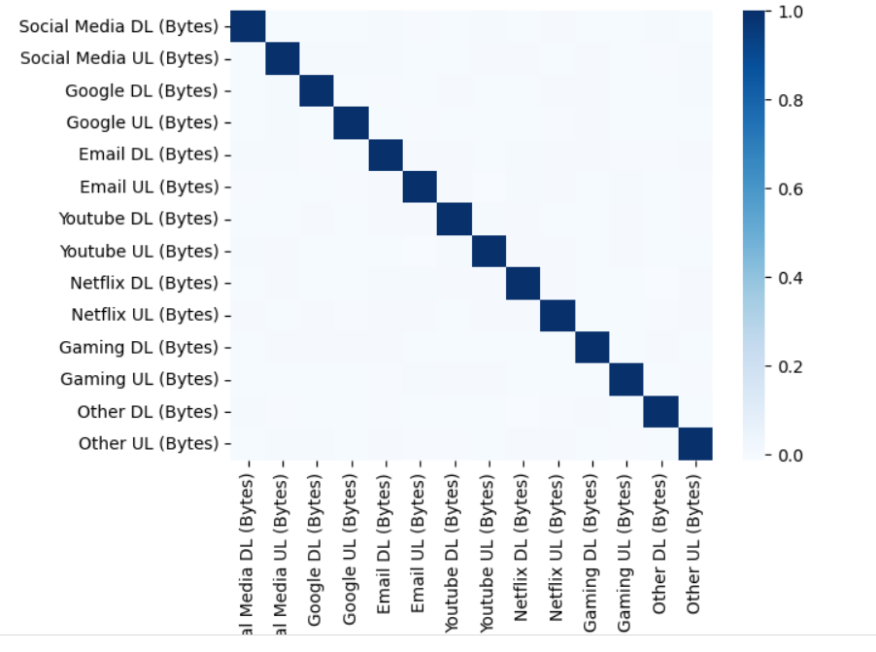
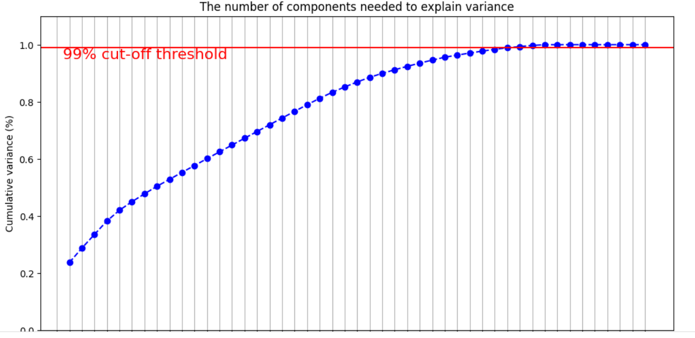
7
Heatmap Correlation
Interpretation:
The curve shows diminishing returns, indicating 10-15 components capture 99% of the variance, ideal for dimensionality reduction and noise filtering.

Slide 9
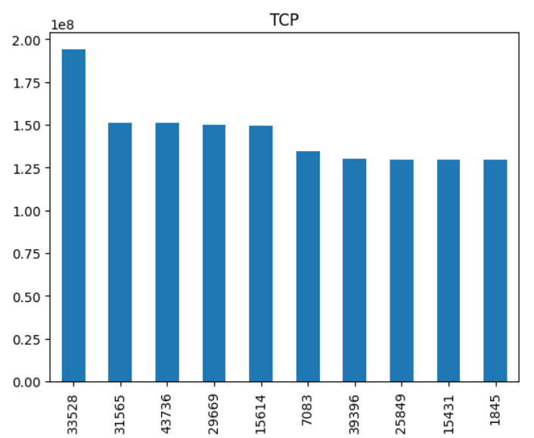
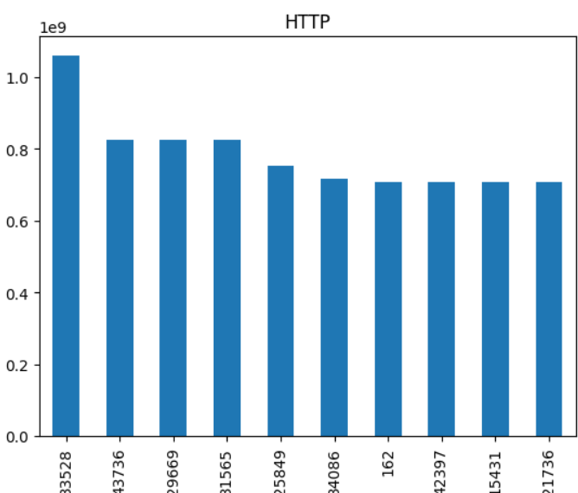
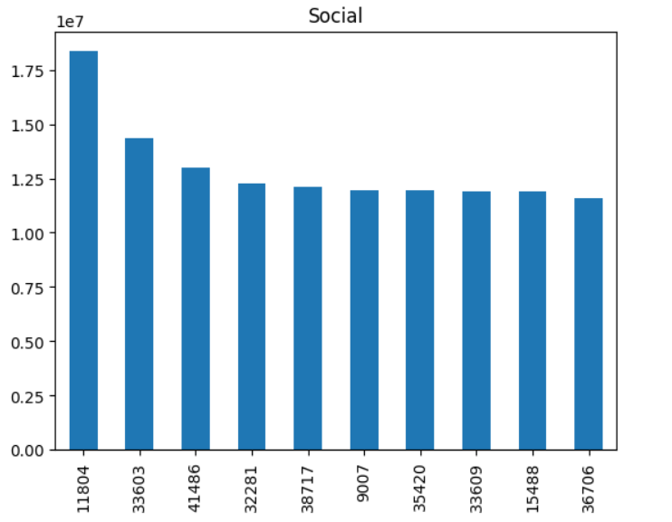
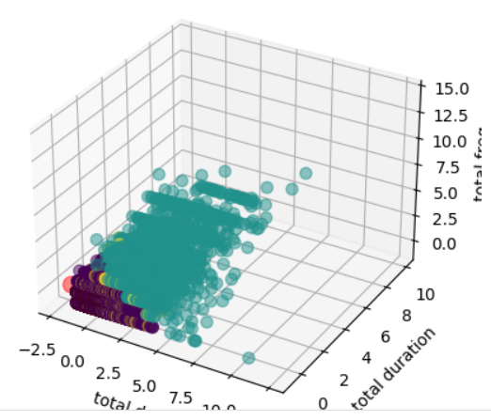
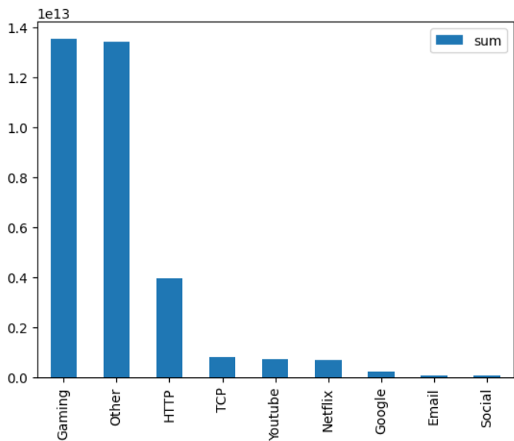
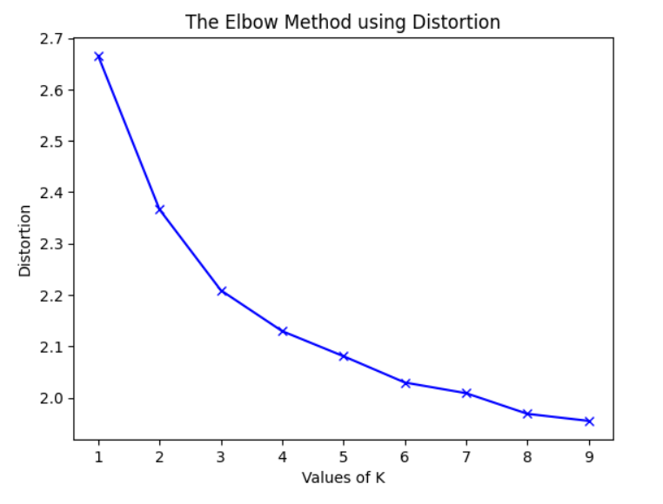
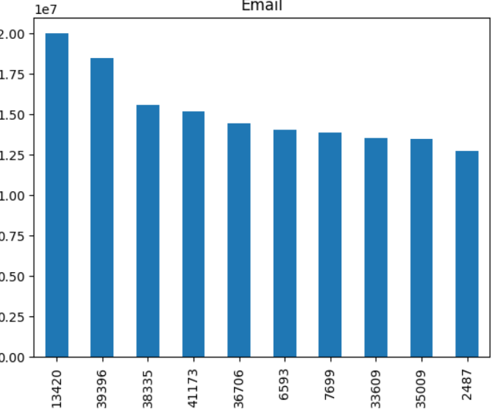
8
Task 2 - User Engagement analysis
top 10 most engaged user per applications
k-means clustering
Interpretation:
Distortion decreases with more clusters, but the elbow point at K = 3 or 4 suggests diminishing returns, making these likely optimal cluster counts.

Slide 10
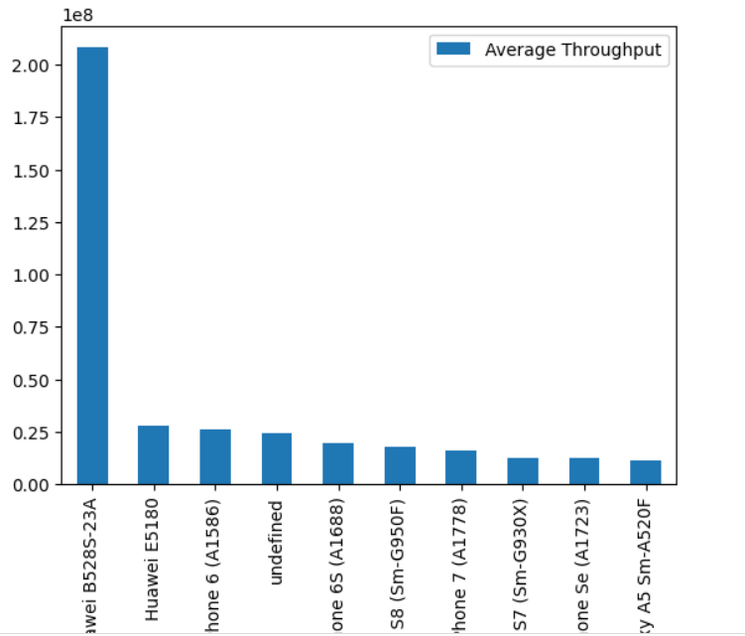
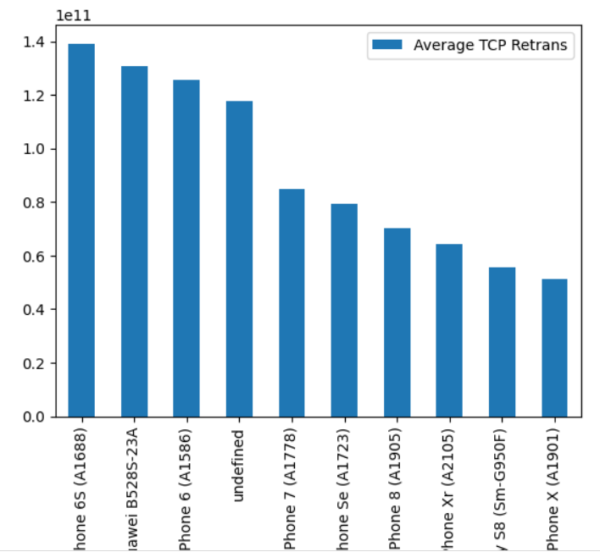
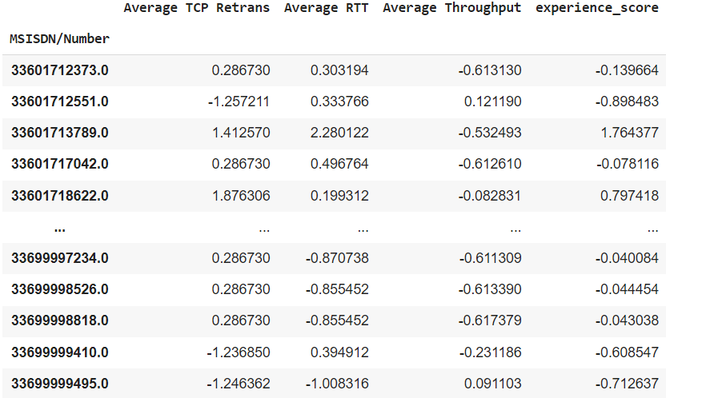
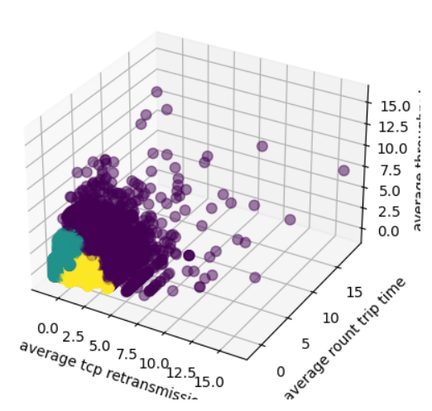
9
Task 3 - User Experience Analysis
Interpretation:
Cluster 2 users face the most network issues, requiring targeted optimizations, while Cluster 0 enjoys the best experience with stable throughput.
Recommendation:
Prioritize improving network conditions for Cluster 2 users and offer targeted customer support, while monitoring Cluster 1 to prevent decline in user experience.

Slide 11
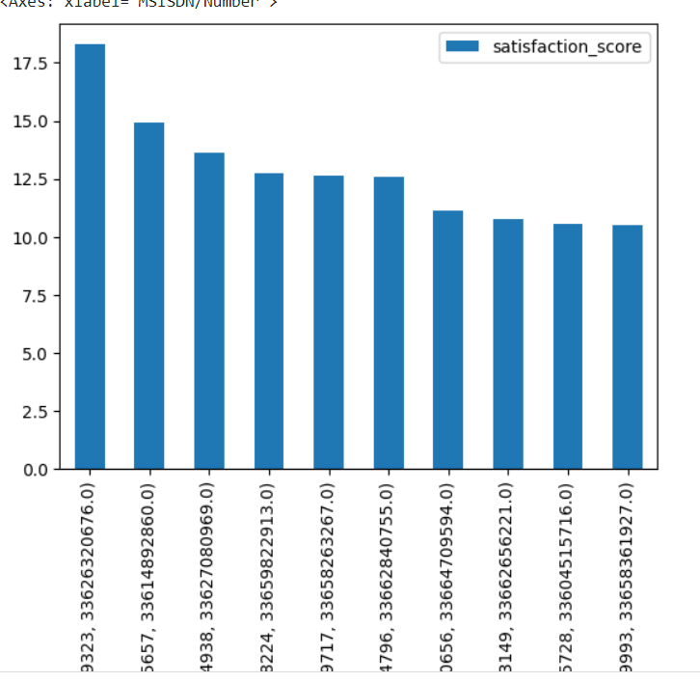
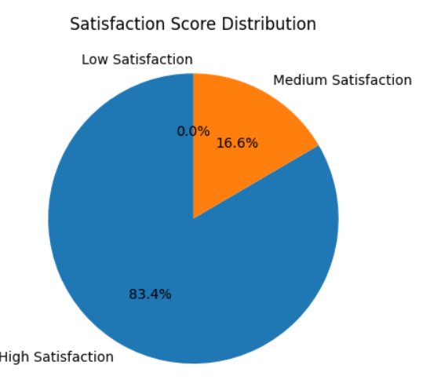
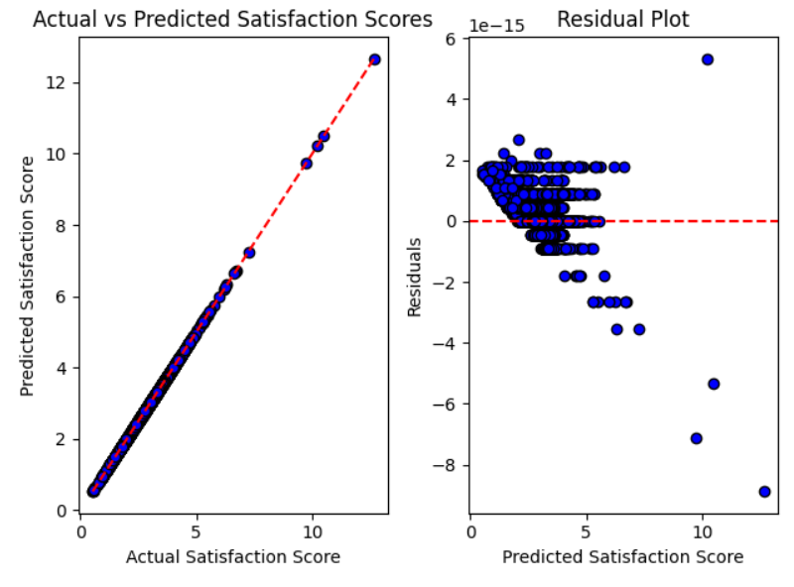
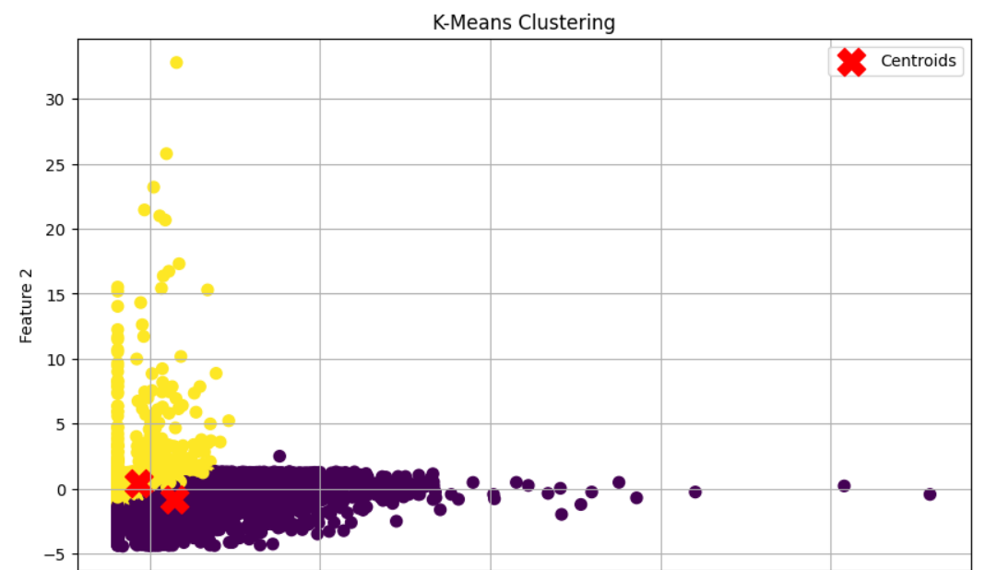
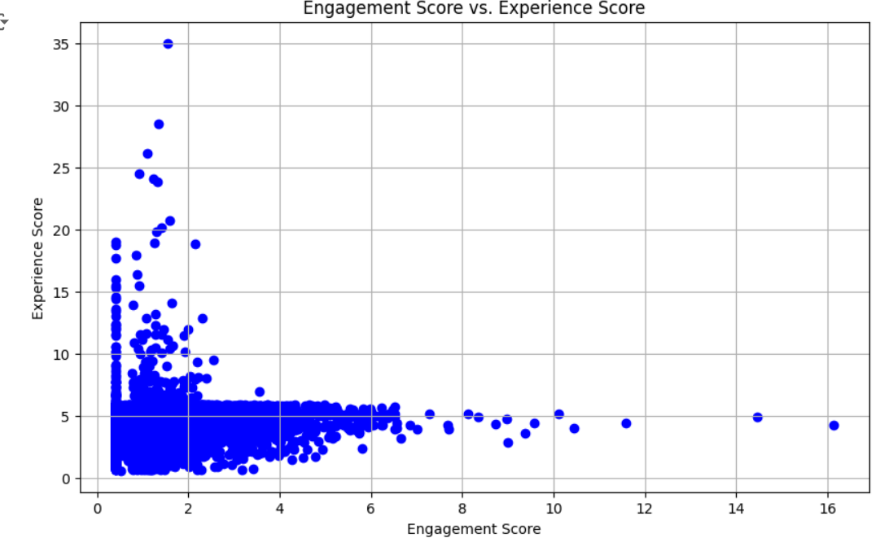
10
Task 4 - User Satisfaction Analysis
Conclusion:
Users in Cluster 1 are generally more satisfied and have better experiences than those in Cluster 0, though their engagement is slightly lower

Slide 12
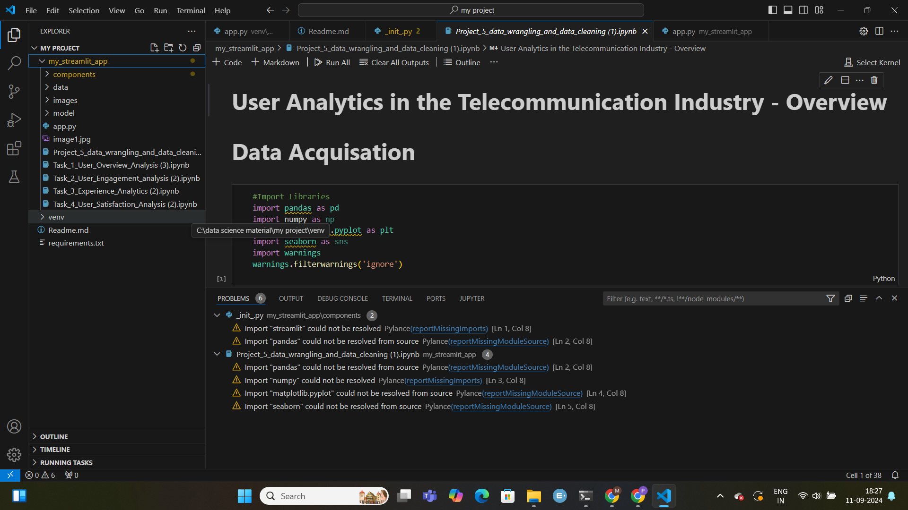
11
Implementation of project in VS Code

Slide 13
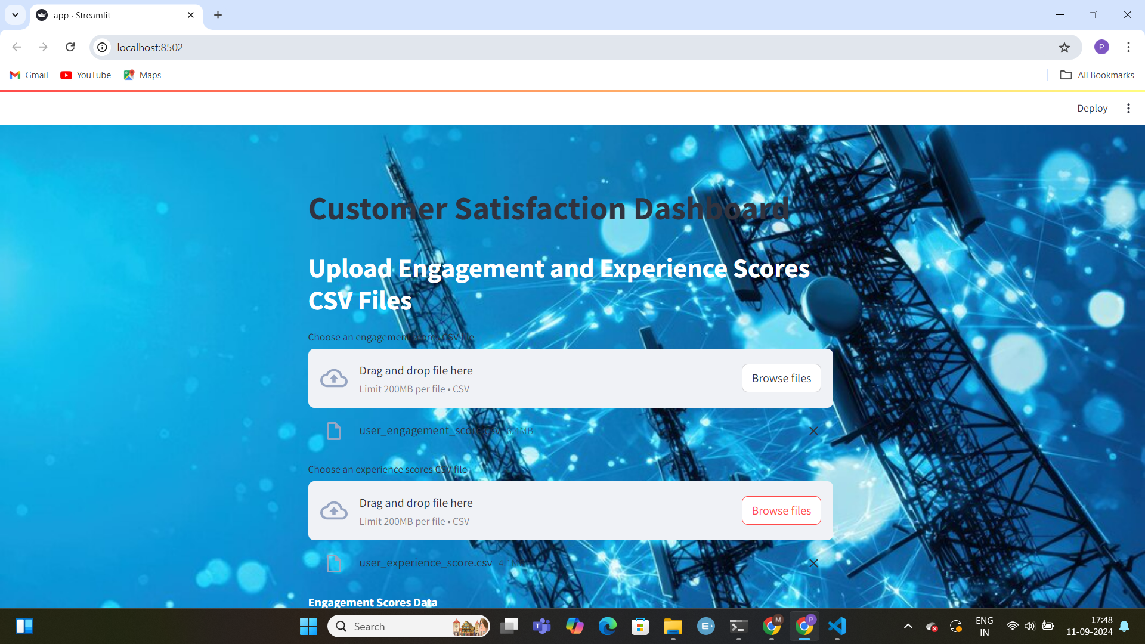
12
Visualizing Insights Through Dashboards using streamlit app

Slide 14
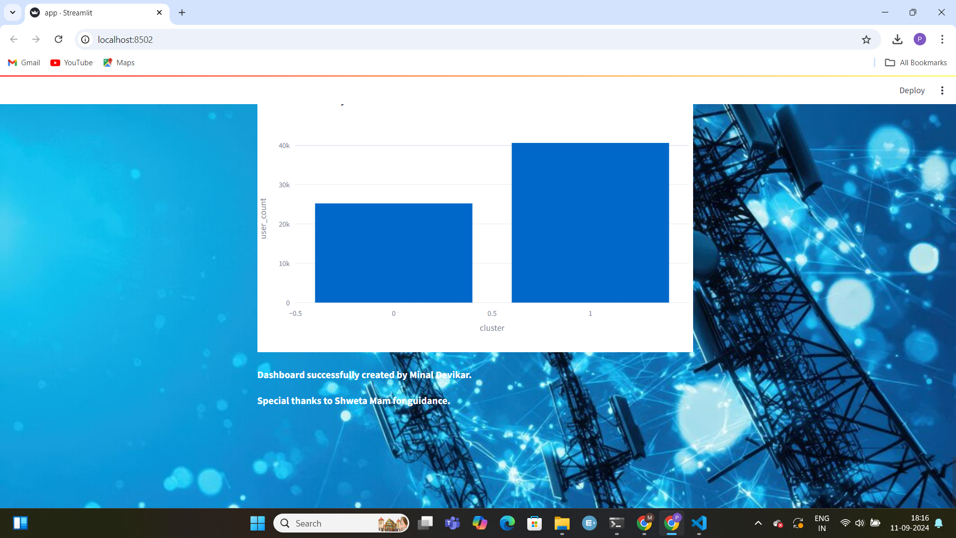

Slide 15
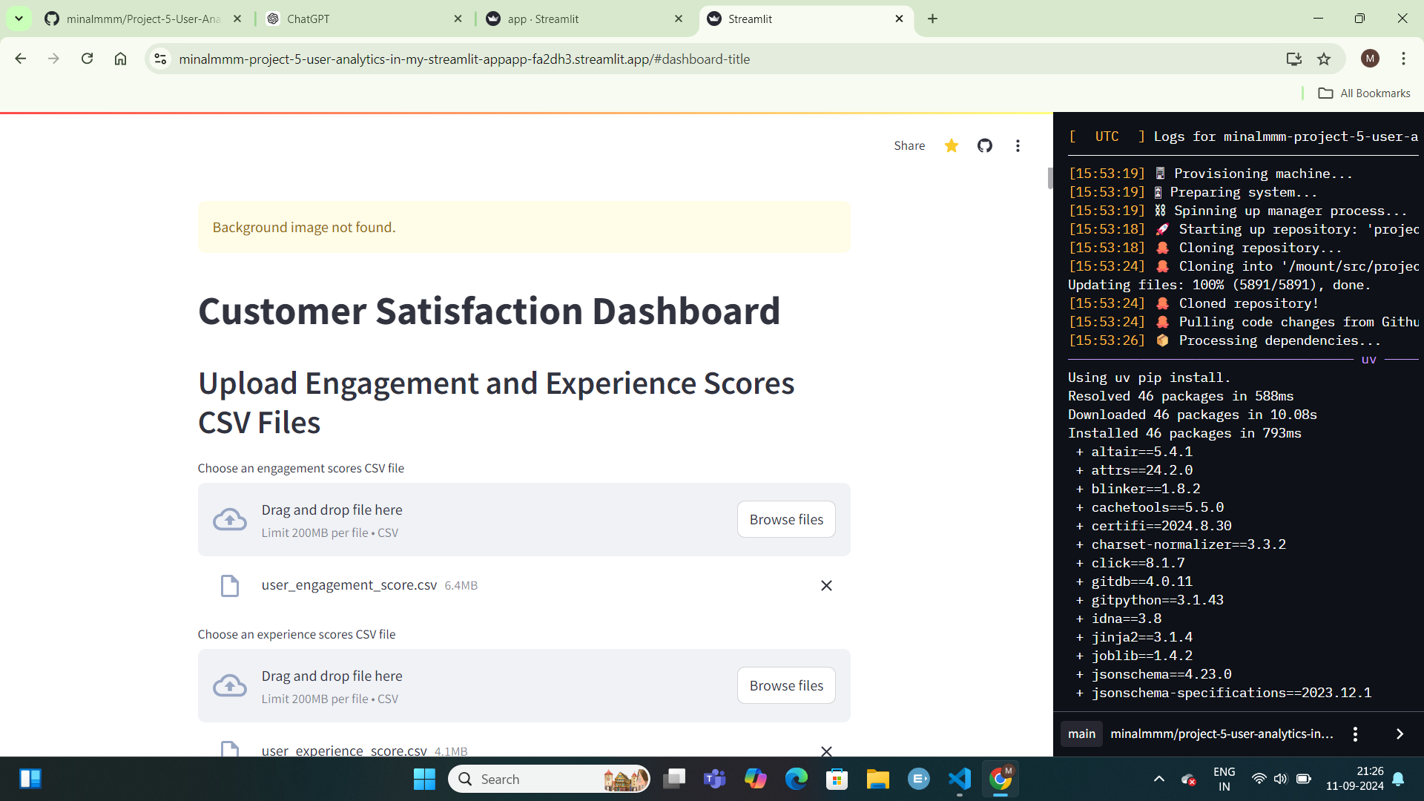
14
Deployment in Streamlit

Slide 16
15
Interpretation and Recommendation
User Overview:
Interpretation: Reveals overall usage trends and identifies the most and least active users.
Recommendation: Focus on retaining high-use customers with special offers and address issues or incentives for less active users.
User Engagement:
Interpretation: Provides insights into how users interact with various services and their overall engagement levels.
Recommendation: Boost engagement by enhancing popular features and targeting users at risk of churn with personalized offers.
User Experience:
Interpretation: Assesses network performance metrics like TCP retransmission and RTT to gauge service quality.
Recommendation: Improve network infrastructure and address performance issues to enhance user experience.
User Satisfaction:
Interpretation: Measures overall customer satisfaction based on engagement and experience scores.
Recommendation: Use satisfaction data to refine customer service strategies and improve service features to increase loyalty.

Slide 17
THANKYOU

